Slide 1
conflict and negotiation

Slide 2
Conflict
Definition
  A process that begins when one party perceives that another party has negatively affected, or is about to negatively affect, something that the first party cares about.
    It describes a point in an ongoing activity when an interaction “crosses over” to become an inter-party conflict.
    It includes a wide range of conflicts that people experience in organizations
      Incompatibility of goals
      Differences over interpretations of facts
      Disagreements based on behavioral expectations

Slide 3

Transitions in Conflict Thought
Traditional View of Conflict (1930s -40s)‏
The belief that all conflict is bad, harmful, destructive, irrational and must be avoided.
Conflict was seen as a dysfunctional outcome resulting from:
Poor communication
Lack of openness
Failure to respond to employee needs
How to solve it?
Avoidance

Slide 4

Transitions in Conflict Thought (cont’d)‏
Human Relations View of Conflict (1940s-70s)‏
The belief that conflict is a natural and inevitable outcome in any group.
Therefore accept it
Interactionist View of Conflict (1970s to present)‏
The belief that conflict is not only a positive force in a group but that it is absolutely necessary for a group to perform effectively.

Slide 5
Functional versus Dysfunctional Conflict
Functional Conflict
Conflict that supports the goals of the group and improves its performance.
Dysfunctional Conflict
Conflict that hinders group performance.

Slide 6

Types of Conflict
Task Conflict
Conflicts over content and goals of the work.
Relationship Conflict
Conflict based on interpersonal relationships.
Process Conflict
Conflict over how work gets done.

Slide 7
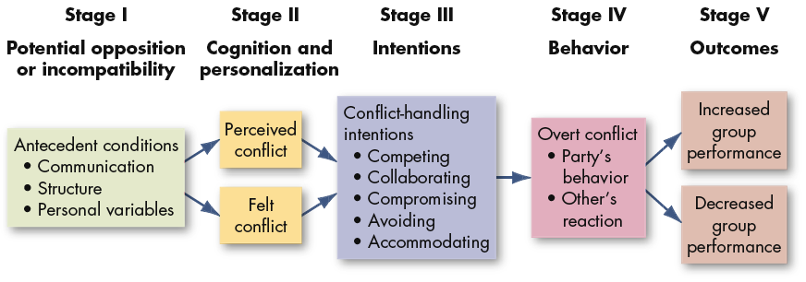
The Conflict Process

Slide 8
Stage I: Potential Opposition or Incompatibility
the presence of conditions that create opportunities for conflicts to arise
Communication
  Semantic difficulties, misunderstandings, and “noise”
  Potential for conflict increases when either too little or too much communication takes place
Structure
  Size and specialization of jobs (larger the group and more specialised = more potential)‏
  Jurisdictional clarity/ambiguity (leads to fight for control of resources)‏
  Member/goal incompatibility (production, finance, logistics, marketing, quality, etc)‏
  Leadership styles (close or participative)‏
  Reward systems (win-lose) – one gains at another's expense
  Dependence/interdependence of groups
  Tenure and conflict (greatest for younger members)‏
Personal Variables
  A person who you dislike almost immediately – looks, speech, mannerisms, behaviour, smile)‏
  Personality, emotions
  Differing individual value systems/judgements
    bias, prejudice
    X thinks he's worth 4.5 but his boss says he's worth 3.75.

Slide 9
Stage II: Cognition and Personalization
if conditions in stage-I negatively affects someone, then potential of stage -I becomes actualised in stage II
Perceived Conflict
Awareness by one or more parties of the existence of conditions that create opportunities for conflict to arise.
Felt Conflict
Emotional involvement in a conflict by an individual, creating anxiety, tension, frustration, or hostility.
The manner in which we define the conflict can lead to either
Negative Emotions
leads oversimplification of issues, reduction of trust, negative interpretation of the other party
Positive Feelings
Thinking win-win
take a broader view of the situation
develop more innovative solutions

Slide 10
Stage III: Intentions
Intentions : Decision to act in a certain way
A lot of conflicts become worse because one party attributes the wrong intention on to the other party
Dimensions used to identify conflict handling intentions:
Cooperativeness:
Degree to which one party attempts to satisfy the other party’s concerns.
Assertiveness:
Degree to which one party Attempts to satisfy one’s own concerns.

Slide 11
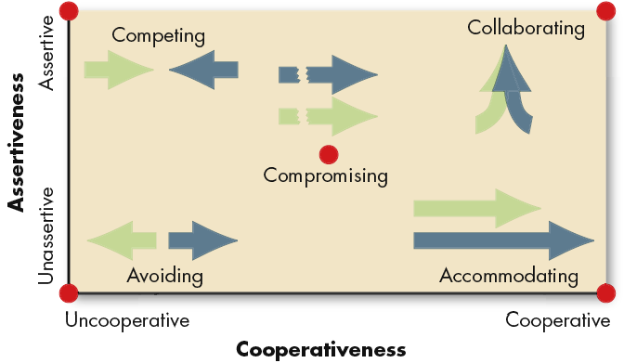
Dimensions of Conflict-Handling Intentions
Source: K. Thomas, “Conflict and Negotiation Processes in Organizations,” in M.D. Dunnette and L.M. Hough (eds.), Handbook of Industrial and Organizational Psychology, 2nd ed., vol. 3 (Palo Alto, CA: Consulting Psychologists Press, 1992), p. 668. With permission.

Slide 12
Stage III: Intentions (cont’d)‏
Competing
A desire to satisfy one’s interests, regardless of the impact on the other party to the conflict.
Collaborating
A situation in which the parties to a conflict each desire to satisfy fully the concerns of all parties. e.g. win -win
Avoiding
The desire to withdraw from or suppress a conflict.
e.g. ignore a conflict or avoid others with whom you disagree

Slide 13

Stage III: Intentions (cont’d)‏
Accommodating
The willingness of one party in a conflict to place the opponent’s interests above his or her own. e.g. win - lose
Compromising
A situation in which each party to a conflict is willing to give up something.
No clear winner or loser
solution does not completely satisfy both parties

Slide 14
In other words, in a Conflict Situation,
  some people want to win at any cost
  some want to find an optimal solution
  some want to run away
  others want to be obliging
  others want to split the difference

Slide 15
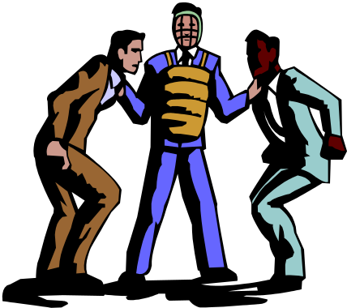
Stage IV: Behavior
This is the stage where conflict becomes visible.
Conflict behaviours are overt attempts to implement each party's intentions
This stage includes statements, actions and reactions of the conflicting parties
As a result of miscalculated judgements, overt behaviour sometimes deviate from original intention
e.g. X demands from Y. Y respond by arguing. X threaten Y and vice versa…

Slide 16
Contd...Stage IV - Behaviour
Question:
If a conflict is dysfunctional, what can be done to de-escalate it?
If conflict is low, what can be done to increase it?

Slide 17
Conflict Management Techniques
Problem solving/ diplomacy
  Face to face meeting of conflicting parties for the purpose of identifying problems and resolving it through open discussion
Superordinate goals
  Setting shared goals that cannot be attained unless each of the conflicting parties cooperate
Expansion of resources
  When cause of conflict is scarce resource (e.g. money, promotion, opportunities, etc..), expand resources and create win-win situation
Avoidance
  Withdrawal from or suppression of the conflict
Smoothing
  Play down differences, focus on common interests between parties

Slide 18
Conflict Management Techniques
Compromise
  Each party to the conflict gives up something of value
Authoritative command
  Management uses formal authority to resolve conflict and communicates its desires to all parties
Altering the human variable
  Using behavioural change techniques (e.g. training in human relations) to alter attitudes and behaviour that cause conflict
Altering the structural variables
  Changing formal organisational structure and interaction pattern of conflicting parties (e.g. job re-design, transfer, etc..)‏

Slide 19

Conflict Management Techniques:
when conflict is low
Conflict stimulation Techniques
Communication
  Using ambiguous or threatening messages to increase conflict levels.
Bringing in outsiders
  Adding employees to a group whose background, values, attitude or managerial style differs from the others
Restructuring the organization
  Realigning work groups, altering rules and regulations, increasing inter-dependence
Appointing a devil’s advocate
  Appointing a critic to purposely argue against the majority positions held by the group

Slide 20
Stage V: Outcomes
Functional Outcomes from Conflict
  Increased group performance
  Improved quality of decisions
  Stimulation of creativity and innovation
  Encouragement of interest and curiosity
  Provision of a medium for problem-solving
  Creation of an environment for self-evaluation and change
  It is an antidote for groupthink
Creating Functional Conflict
  Reward dissent and punish conflict avoiders. (HP, IBM)‏
  Build devil’s advocate
  Increasing heterogeneity in groups

Slide 21
Stage V: Outcomes
Dysfunctional Outcomes from Conflict
  Development of discontentment
  Reduced group effectiveness
  Retarded communication
  Reduced group cohesiveness
  Infighting among group members overcomes group goals
  Final result? Group may not survive as members do not get along

Slide 22

Negotiation
Negotiation
A process in which two or more parties exchange something of value to them and attempt to agree on the exchange rate for them.
Generally two approaches to negotiation

Slide 23

Bargaining Strategies
Distributive Bargaining
Negotiation that seeks to divide up a fixed amount of resources; a win-lose situation.
e.g.labour – management negotiation over wages
Essence of distributive bargaining is negotiating who gets what share of the ‘Cake’.
Bottomline: When parties believe the pie is fixed, they tend to bargain distributively

Slide 24
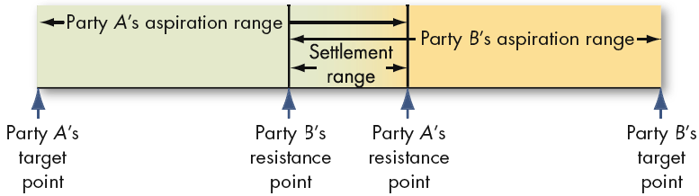
Distributive Bargaining
Staking Out the Bargaining Zone
Make the first offer with favourable terms. It shows power
How to get opponent nearer to your target?
Arguing that your target is fair
Get opponent to feel emotionally generous to you
Use ‘good cop – bad cop’ routine (start with bad cop)‏
Revealing a deadline – this speeds up concession from the other party

Slide 25
Bargaining Strategies
Integrative Bargaining
Negotiation that seeks one or more settlements that can create a win-win solution. (e.g. sales order vrs credit from Co.)‏
Why don’t we see more integrative bargaining in organisations?
Several conditions to be met:
parties must be open and clear about their concerns
Sensitivity by both to the other’s needs
Ability to trust one another
Willingness by both to be flexible
  Solution? Try bargaining in teams
Don’t compromise while negotiating a win-win settlement
(e.g. two sisters with an orange)‏

Slide 26
Distributive Versus Integrative Bargaining
Bargaining Distributive Integrative
Characteristic Characteristic Characteristic
Goal Get maximum from Expand the pie so that both win
the pie parties are satisfied
Primary motivations I win, you lose I win, you win
Primary interests Opposed to each other Convergent or congruent
with each other
Focus of relationships Short term Long term
Focus position (I cant go Interests (Can you explain beyond this point) why this issue is so important to you

Slide 27
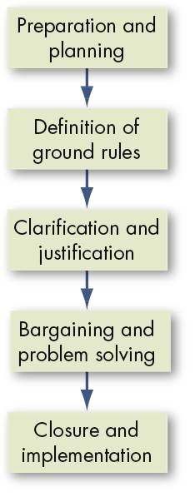
The Negotiation Process

Slide 28
1. Preparation and planning
Do your homework
Try to know
  What’s the Nature of conflict?
  History leading to negotiation
  Who’s involved?
  What are their perceptions?
  What do you want from the negotiation?
  What are their goals?
  What hidden interest is important to them?
  What might they be willing to settle on?
Put your goals in writing
Develop a range of outcomes (most hopeful to minimally acceptable)‏
Once you collect the information, develop your strategy
The Best Alternative To a Negotiated Agreement- BATNA
  the lowest acceptable value (outcome) for you in a negotiated agreement.

Slide 29
2. Definition of ground rules
Defining the ground rules and procedures with the other party
  Who will do the negotiating?
  Where will it take place?
  What time?
  What issues will be negotiated?
  In case of an impasse, what will be the next step?
During this phase, parties also exchange their initial proposals

Slide 30
3. Clarification and justification
Both parties
  Explain, amplify, clarify, bolster, justify their demands/proposals
  Need not be confrontational
  It is an opportunity to educate and inform each other on the issues which are important to each and why.

Slide 31
4. Bargaining and problem solving
Give and take
Work out an agreement
At this stage, concessions will have to be made
This is the essence of negotiation

Slide 32
5. Closure and implementation
Formalizing the agreement and developing a process to implement and monitor the deal
This may be in the form of a formal contract or in some cases….a formal handshake.

Slide 33
Issues in Negotiation
The Role of mood & Personality Traits in Negotiation
  Mood matters in negotiation
    Upbeat or happy negotiators are likely to come up with better outcomes
  Why? Tend to trust other party more & reach more joint-gain settlements
  What about personality traits?
    Big 5 is related to negotiation outcomes
    Agreeable or extrovert are not successful – why? But good for integrative negotiations
    For distributive negotiations, disagreeable introvert seems more suitable.
    Big ego also affect negotiations
      How? Such individuals are concerned with appearing competent and successful (they want to look good personally rather getting the best deal for all concerned.

Slide 34
Issues in Negotiation
Gender Differences in Negotiations
  A popular stereotype: women are more cooperative and pleasant in negotiation
  Women negotiate no differently from men, although men apparently negotiate slightly better outcomes.
  Men and women with similar power bases use the same negotiating styles.
  Another Stereotype: women are ‘nicer’ men are ‘tougher’

Slide 35
Cultural differences in negotiations
Negotiating styles varies across national cultures
French like conflict – take a long time to negotiate agreements – does not bother whether opponents like or dislike them
Chinese – believe negotiations never end
Japanese negotiate to develop a relationship and commitment to work together
Americans are impatient and have a desire to be liked

Slide 36

Third-Party Negotiations:
When differences are hard to resolve
Mediator
A neutral third party who facilitates a negotiated solution by using reasoning, persuasion, and suggestions for alternatives.
The conflicting parties must be willing to bargain and resolve their conflict
Mediator must be seen as neutral and non-coercive
Arbitrator
A third party to a negotiation who has the authority to dictate an agreement.
Arbitration can be voluntary or compulsory
Always results in a settlement

Slide 37

Third-Party Negotiations (cont’d)‏
Conciliator
A trusted third party who provides an informal communication link between the negotiator and the opponent.
In practice, conciliators act as mere communication conduits
Consultant
An impartial third party, skilled in conflict management, who attempts to facilitate creative problem solving through communication and analysis.
Consultant’s role is not to settle the issue, but to improve the relations between the parties, so they can reach a settlement themselves

